Slide 1
Bishop Blanchet Robot Controls
FRC Rapid React 2022

Slide 2
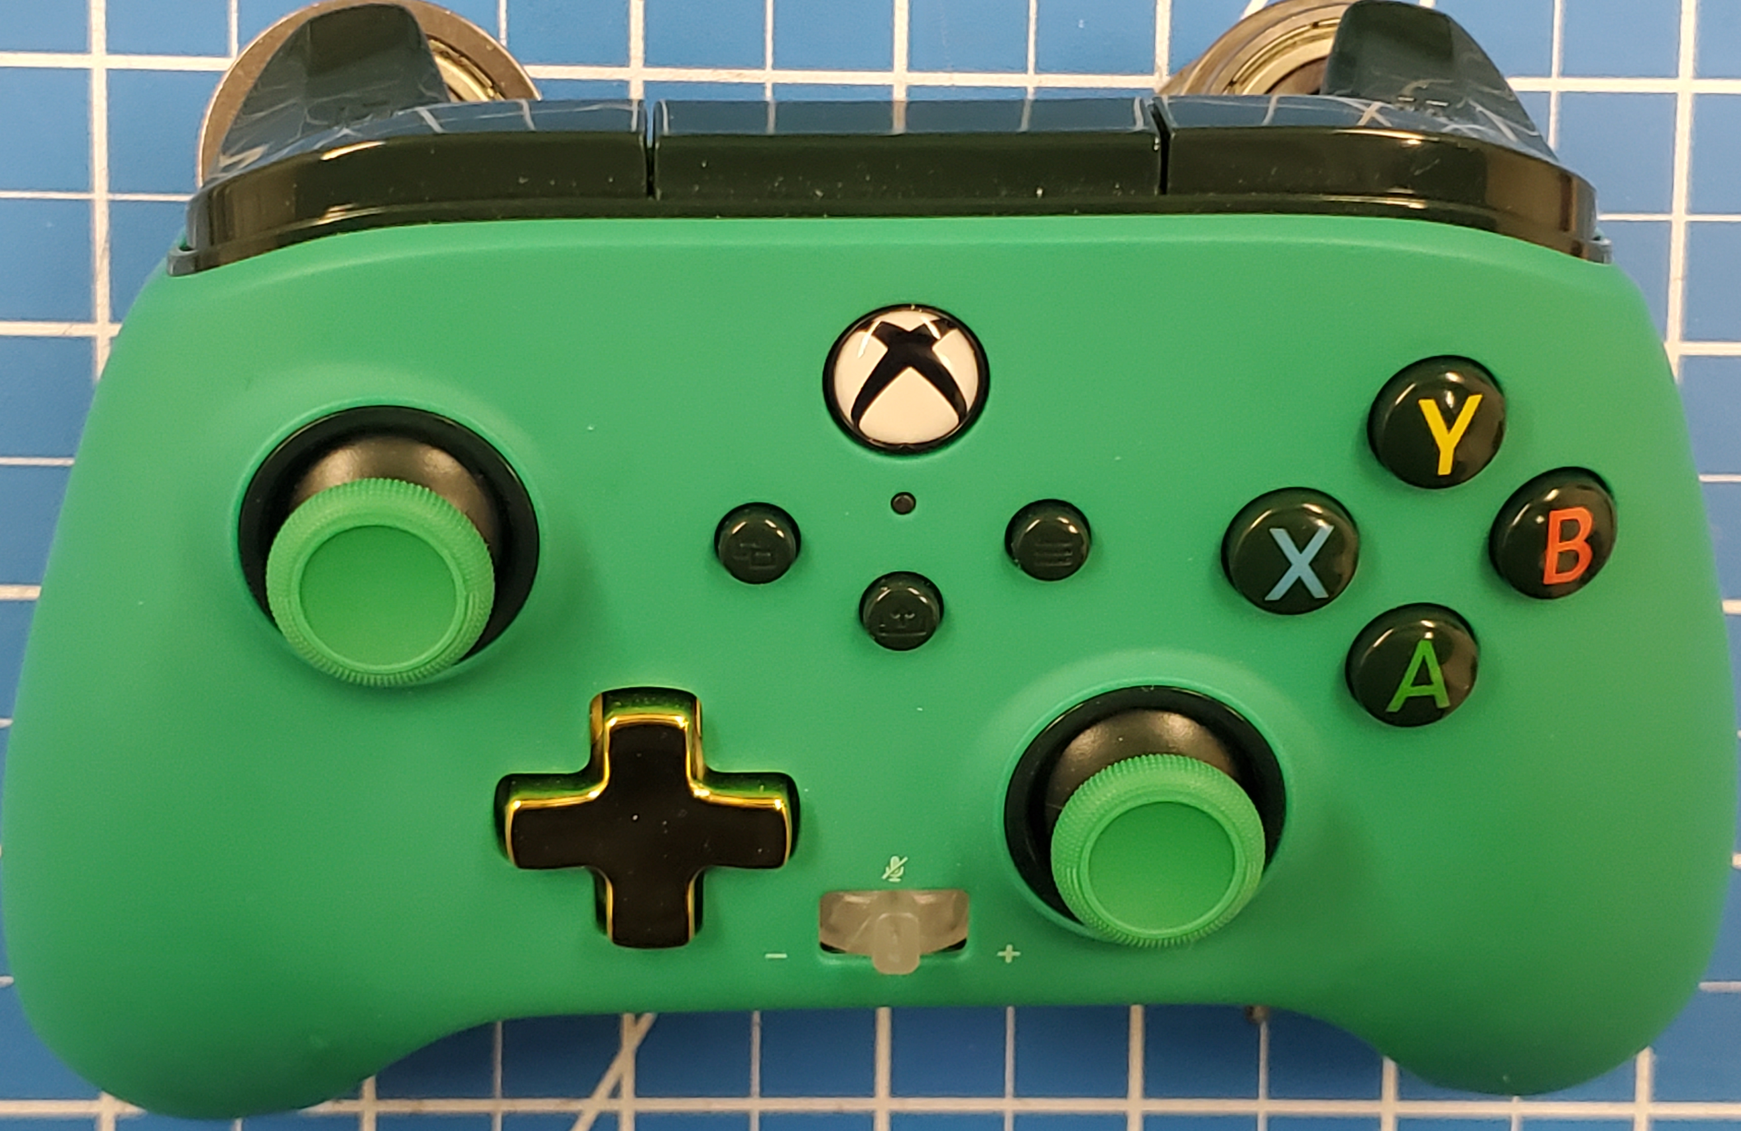
Driver Controller Actions
Left Joystick Button:
Arcade robot drive

Slide 3
Button Board Automated Commands
Angle Arm Connection
Climbing
Jaws Position
Ball Control
Engage Jaws
Mid
Fwd High
Shoot High
Engage Chassis
High
Rev High
Shoot Rev High
Traversal
Fwd Low
Shoot Low
Fwd Intake
Intake

Slide 4
Co-driver Controller Actions – overrides
Left Bumper: Stage 1 Ball Storage single speed (while pressed – ball storage stopped after release)
Right Bumper: Ball Retrieval
single speed (while pressed – ball storage stopped after release)
Right Trigger: Ball Shooter
variable speed
Left Trigger: Ball Intake
variable speed
Y Button: Angle Arm
top pneumatic in/out
(when pressed)
Left Joystick:
Ball Jaws up/down
variable speed
B Button: Angle Arm
bottom pneumatic in/out
(when released)
Left Joystick Button: Jaws Clutch lock/unlock
(when pressed)
Right Joystick:
Telescoping Arm up down
variable speed

